Slide 1
Index R(x): Prescriptions for Performance Improvement
SQL Saturday Jacksonville 2023
Bill Sanscrainte
Bill@Sanscrainte.com
Notes:
00:00/00:15

Slide 2





















Please Visit and Thank Our Sponsors!
Notes:
00:15/00:15

Slide 4

SQL
Clinic
Get your SQL Questions answered here by our SQL Experts

Slide 5

501 Legion Charitable Donation
Thank the 501 Legion for Supporting Our Event!
JSSUG Will Match Donations up to $500
Donation Bucket on Registration Table

Slide 6
Session Evaluations
Your feedback is important to us!
Please fill out and hand to speaker after the session!

Slide 7
Event Evaluation
Fill out event evaluation card in your bag and visit all sponsors to be entered to win an Xbox Series X – (Must be present to win)

Slide 8
sp_WhoIsActive?
Bill Sanscrainte linkedin.com/in/billsanscrainte Bill@Sanscrainte.com
40+ years with Relational Data
SQL Server since 6.5
1984 - Wrote first SQL query leading first data warehouse project
1994 - Started independent Data Consulting practice
2001 – Started version 1 of what’s presented today
Record holder for most SQL Cruises as a student – SQL Server 10, Oracle 2
Notes:
00:30/00:45

Slide 9
Why are you here?
“Poorly designed indexes and a lack of indexes are primary sources of database application
bottlenecks”
Learn.Microsoft.Com 2022
Notes:
01:15/00:30
And we all know - It’s always the database at fault!
What does DBA stand for? Dumb But Adorable?
Default Blame Acceptor

Slide 10
Legacy Approach for Index Improvement
1000’s of SQL community scripts for finding index improvements
Like the truth they are “out there” – some good, some …
“Some assembly required” & “Batteries not included”
Execute each script individually*
Copy & paste to collect results
Link related items across result sets
Re-format for display and analysis
Sort by database, table, index
Take a guess at what to do next
Use hunches to figure out what goes first
*Except sp_Blitz_Index in the First Responder Kit by Brent Ozar
Notes:
01:45/01:00
If you have a monitoring tool your mileage may vary

Slide 11
Special Thanks !
Brent Ozar | Tim Ford | Kimberly Tripp | Jared Westover
Glenn Berry | Kevin Kline | Paul Randall | Edward Pollack
Pinal Dave | Jason Strate | Aaron Bertrand | Kendall vanDyke
Tom Collins | Kendra Little | Ahmad Yaseen | Niko Neugebauer
And many more
Notes:
02:45/00:15

Slide 12
Let’s Try it a Different Way …
Grab data from 83 DMVs, System Views, and System Functions in one script …
Consolidate results at Index, Table, Database, and Total levels
Compute & aggregate performance metrics by Index > Table > Database > Total …
Perform diagnostics by Index, Table, Database, Instance …
Prescribe action(s) for every Index …
Prioritize prescriptions by Table …
Present and analyze in Excel
Notes:
02:45/01:00
Includes Index metadata, performance metrics, DBCC Showstatistics, Missing Indexes, Foreign Keys, SQL Table Valued Functions, Indexed Views
930 columns
Prioritize – table level
Excel 2013+

Slide 13
Notes:
04:00/00:30 NO CLICK
Tada! End product – an Excel workbook taking advantage of Excel’s many presentation and analytic features
No need to squint – we’ll explore each principal piece in more detail
WideWorldImporters sample database
Total of 460 rows – 1 Instance, 1 Database, 33 Data tables, 17 Archive tables
51 “Internal tables” with 65 indexes
99 foreign keys, 193 heaps and indexes, 4 missing indexes
Data from the 83 sources compiles to 469+ data points per index
- would not fit on one screen!
- So how do we present it?
<NEXT SLIDE CONTINUES>

Slide 14

Notes:
Goals:
<*> Reduce scrolling, Compress actionable data as possible into a single 1080p screen
<*> Go vertical in cells – multiple lines for descriptors
<*> Further squeeze cell display – cells expand wide & tall as you click on them
> Shrink back when you click on another cell
<*> Rotate labels to squeeze columns, unlike SSMS
<*> Color shading indicates BAD (RED) to GOOD (GREEN) – notice that no table is all “bad” or all “good”
<*> Data Filters turned on, click on column label sorts that column
<*> Buttons and drop down to control display (more later)
<*> All levels in sheet – Instance, database(s), tables, indexes, with ability to “drill down” to the next level
- Using “Table Priority” column “B”
<NEXT SLIDE CONTINUES>

Slide 15

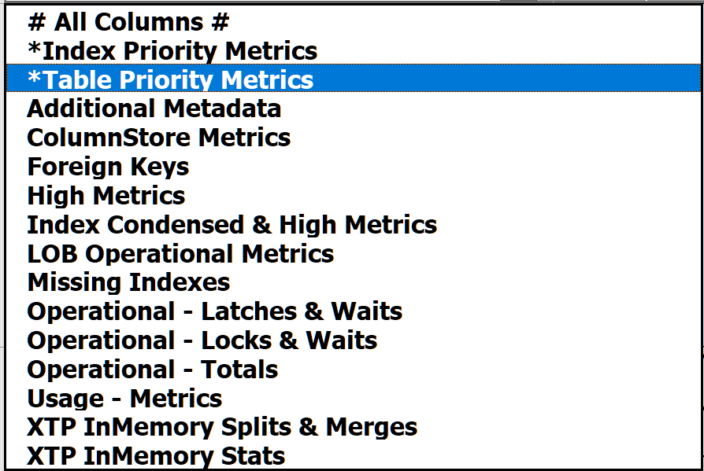
Notes:
05:15/00:45 DON’T CLICK YET
Based on WideWorldImporters
- running Data Load Simulation proc and some custom scripts
- All data returned directly from SQL – no copy paste
sorted in Table action priority order descending – more on that later
Metrics we will see are exaggerated
<*> To save you from being overwhelmed only selected columns are shown
- Drop down chooses topic from “235” columns in the sheet – column group by topic area
- Selection by the drop down in top left corner
- Starts with “table priority metrics” – starting point for your prioritized prescripted index performance improvement journey

Slide 16
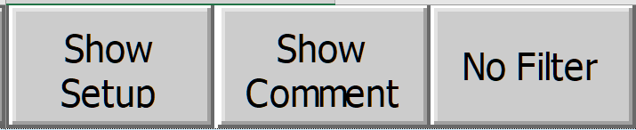

Notes:
06:00/00:45
Dropdowns and buttons to speed insights
Show/Hide Setup Toggle – control display for choosing columns to show and hide, plus display properties
- Edit existing column & create new groups based on research to perform
- If we have time -or- for another session
No/Remove filter – show all rows after drilldown or filtering results using Excel’s data filters
Show/Hide Comment Toggle – show/hide Excel’s Cell Comment feature
- Uses Excel’s comment feature to provide column-level narrative

Slide 17
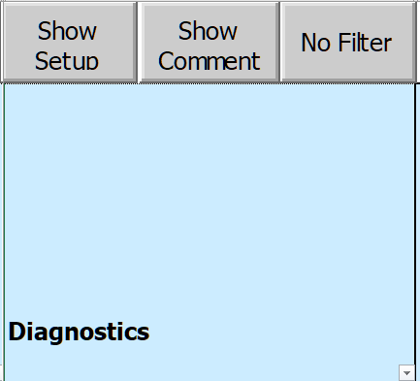
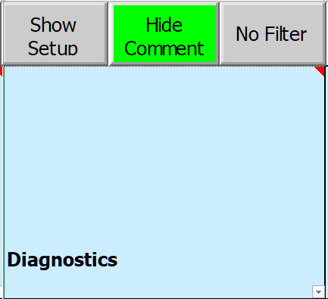
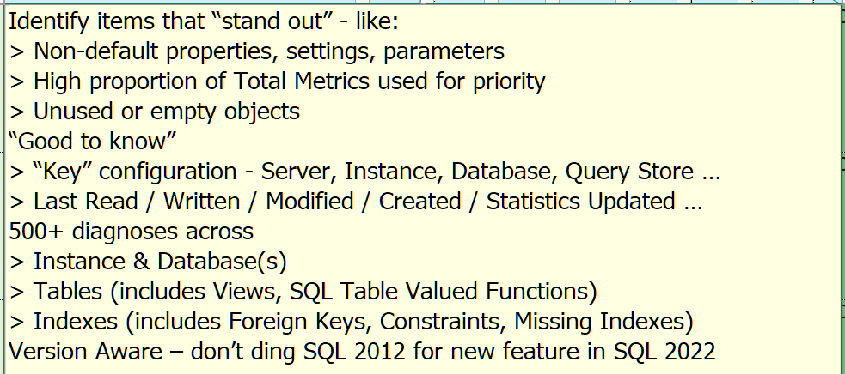
Notes:
06:45/00:45
Click the “Show/Hide Comment” button to enable cell comments
Triangle in top right corner of column label shows comment available
for information about each column heading
Excel likes to resize & relocate comments, so to be consistent click on column label
With a click on column label, sized & positioned to show all comments same place on screen

Slide 18
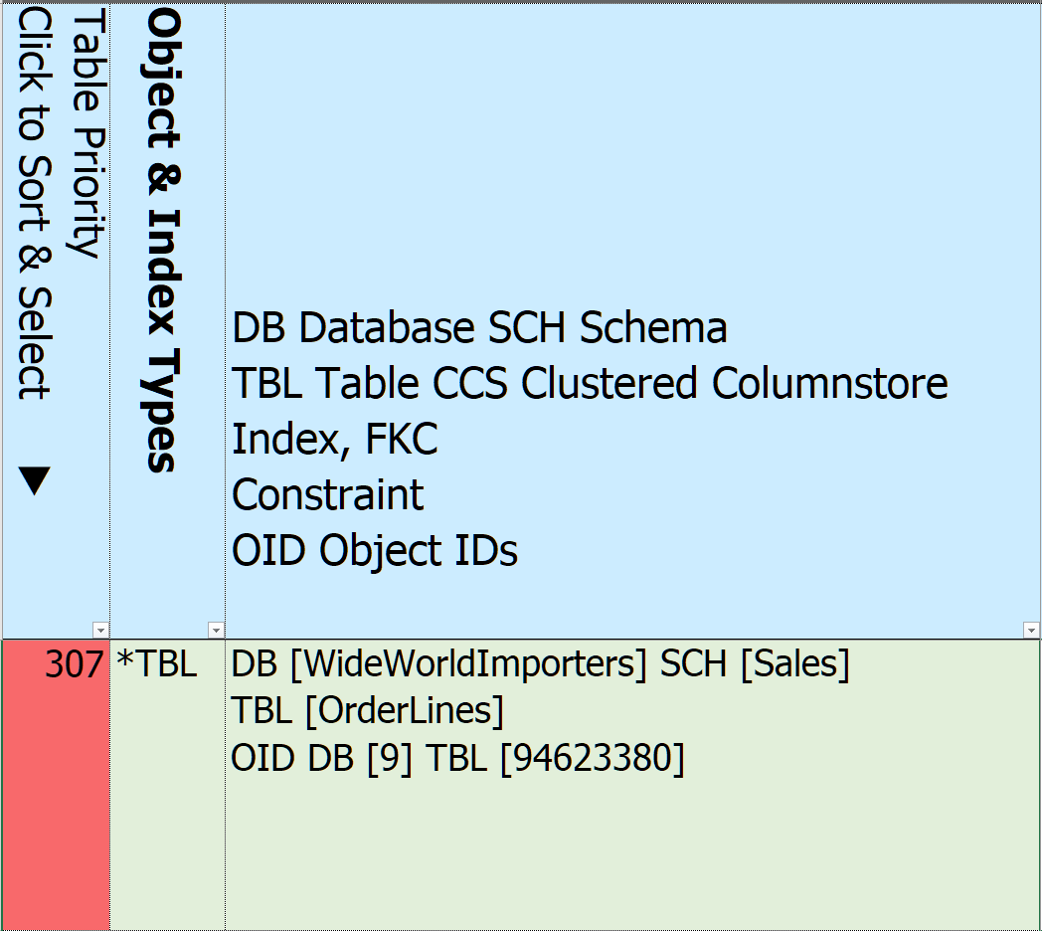
Notes:
07:30/01:00
Column Labels – click to sort. Triangle display direction, click again to sort in opposite order
Table Priority – computed based on overall SQL Index Performance metrics – more on that later
Click column heading to sort
Click in row to drill down to indexes
Object & Index Types – abbreviations for principal types, allows for quick grouping by related type
– e.g all clustered indexes, all in memory tables
Database, Schema, and Table name, along with their IDs
Records for Instance and each Database also created

Slide 19
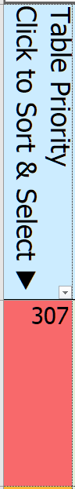
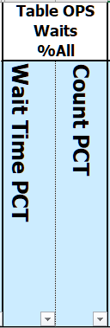
Notes:
08:30/01:00
How did we get to the topmost priority table value 307?
<*> 24 metrics that contribute to table-level performance priority
Start by showing all of the metrics that go into the priority computation - highlighted column labels
<*> For example, let’s explore Table-level aggregate Wait Times and Wait Counts
- All index operation wait times since last reset, divided by the total sample index wait times
- click column label & sort descending
Remember our table [OrderLines]

Slide 20
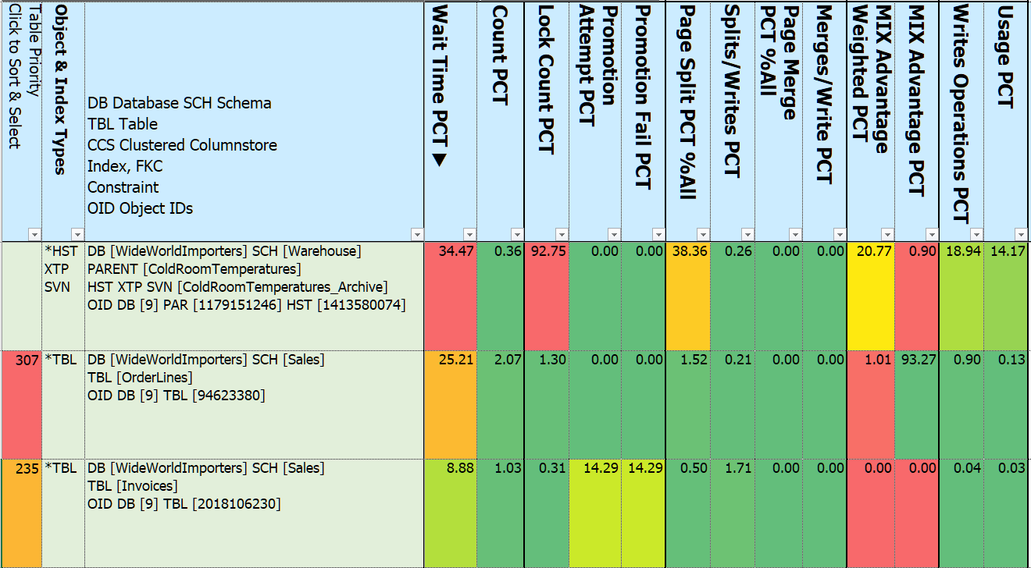
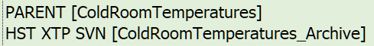
Notes:
09:30/01:00
<*> clicked the column heading Wait Time from the Index Operations metrics to sort DESCENDING
<*> triangle points the sort direction
<*> We’ve zoomed in on the first table-level 13 metrics columns
<*> Over 1/3 of all sample waits are linked to this table
<*> This history table is also noteworthy for High Lock Counts
<*> and Page Splits
<*> The most waited table is a History InMemory System Versioned Temporal Table
- It’s Parent table is [ColdRoomTemperatures] – more on that in a moment
<*> No priority assigned to this table – it’s System created and there’s little we can do about it – except drop it?
Same parent-child behavior exists with other type of SQL Server history tables
- Change Data Capture (CDC) and Ledger tables (new in 2022)
Click again on the Table Wait Time percent & sorts …

Slide 21
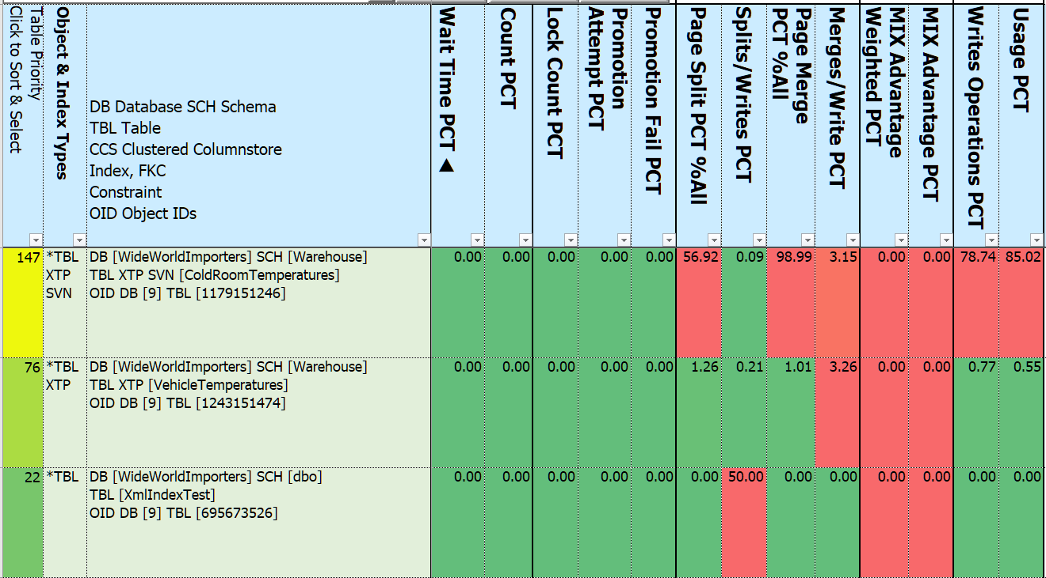
Notes:
010:30/01:00
Ascending – note that there can be great variability across priority metrics
InMemory System Temporal Versioned table [ColdRoomTemperatures]
Table only has 4 rows, but is updated every 75 seconds or so
everything gets re-written to Archive table
the other side of what we just saw with the DESCENDING sort
splits & merges high as percent of total
Not so high as percent of all write activity

Slide 22
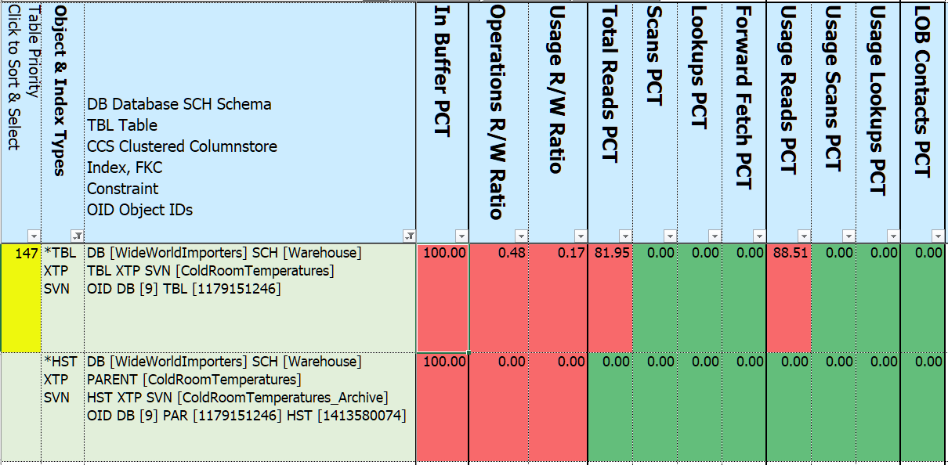
And even more “Children” – System Internal Tables
Notes:
11:30/1:00 demo database
Let’s put the parent and child ColdroomTemperatures together to get a glimpse of the bigger picture
Using data filters look for [ColdroomTemperatures]
<*> And show the remaining 11 priority metrics columns
<*> In Buffer 100% - since both InMemory objects all in memory
<*> Parent reading after writing is 82% of all reads
<*> Once archived, no reads
Strangely, the Usage metrics Reads percent is greater than the Operations – query fired more than records found?
<*>Index details can be found by clicking column “B” – table priority - more
<*>And – even more Parent-Child
Internal Tables
Auto generated to support History Tables, XML, FullText, Spatial, Hash Indexes
Typically don’t contain user-accessible data
Fixed schema - alterations not allowed
e.g. XML_INDEX_NODES CHANGE_TRACKING
Metrics separate from the Parent table
So how do these 24 metrics columns combine to create a priority?

Slide 23
Prioritizing – Table* Share of Total Metrics
Waits – Total time, Total count ++++++
Missing Index Advantage (weighted) +++++
Memory Buffer Percent of Index (exclude InMemory) +++++
Locks – Total count, Promotion Attempts, Promotion Fails ++++
Page Splits, Merges ++++
Heap Forwarded Fetch ++++
Total Writes – Operations, Usage +++
Reads - Scans, Lookups ++
LOB – Fetch, Overflow Fetch, Column Value pull in/push off ++
Read to Write Ratio – Operations, Usage +
*Excludes History (CDC, SVN, LDG) & System Internal Tables
Notes:
20:00
How do we know where to start?
Tune access at the table level – the ultimate source and destination for our queries
What makes SQL Server work harder to retrieve and maintain data?
Usage – per query, Operations – per use
FOOTNOTE Excludes History (CDC, SVN, LDG) & System Internal Tables
- change Data Capture, System Versioned, and Ledger
- System Internal Tables are “internal” tables and indexes created by SQL Server to support
some history activities and non-rowstore index types - XML, SPATIAL, FULLTEXT, HASH
The “Total” is either a single database chosen at run time, or all USER databases
Getting back to the spreadsheet …

Slide 24
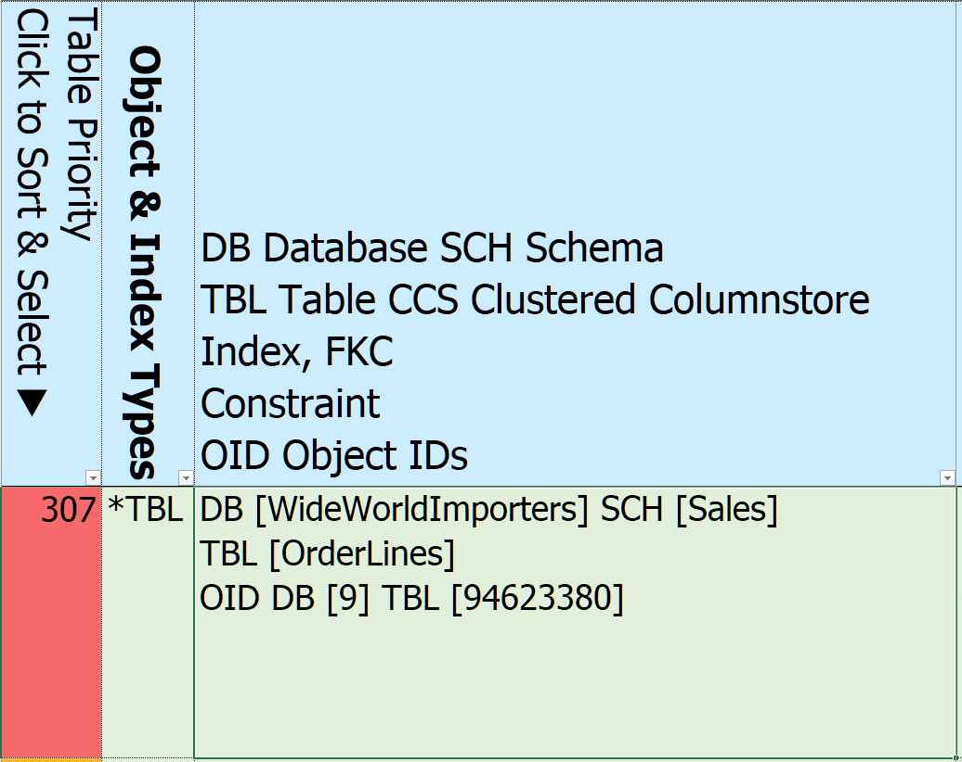
Notes:
15:30/00:30
Highest rated table is [Sales]. [OrderLines]
Click on the “307” to drill down to the index level

Slide 25
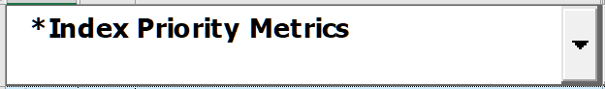
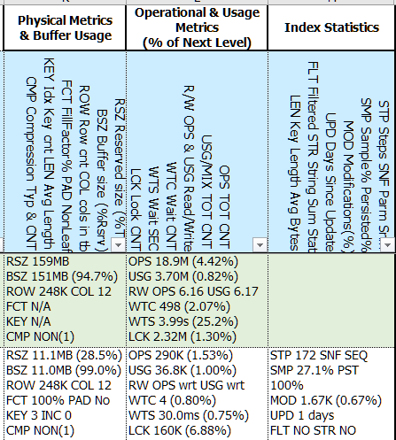
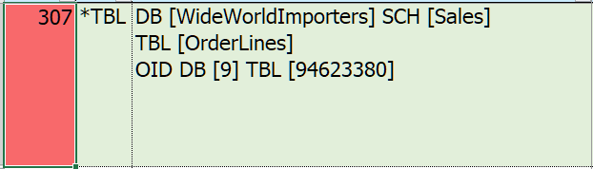
Notes:
20:00/01:00
<*> Index Priority Metrics – drilled into index level
<*> show table information
<*> First 11 of the 22 “Index” objects for table Orderlines in the Sales schema - sorted
Clustered index, Nonclustered Columnstore, 13 nonclustered indexes
4 covered foreign keys, 1 uncovered foreign key, 1 missing index
Also includes child tables and their indexes
- History (CDC, System Versioned, Ledger)
- Internal (supporting the “special” index types XML, SPATIAL, FULLTEXT, HASH)
<*>Looks like a lot, but …
Mostly same columns as Table Priority Metrics
But Metrics are now at the index level as a percent of the table totals
<*> 6 Packs
<*> Key & Included Columns
<*> Prescriptions

Slide 26
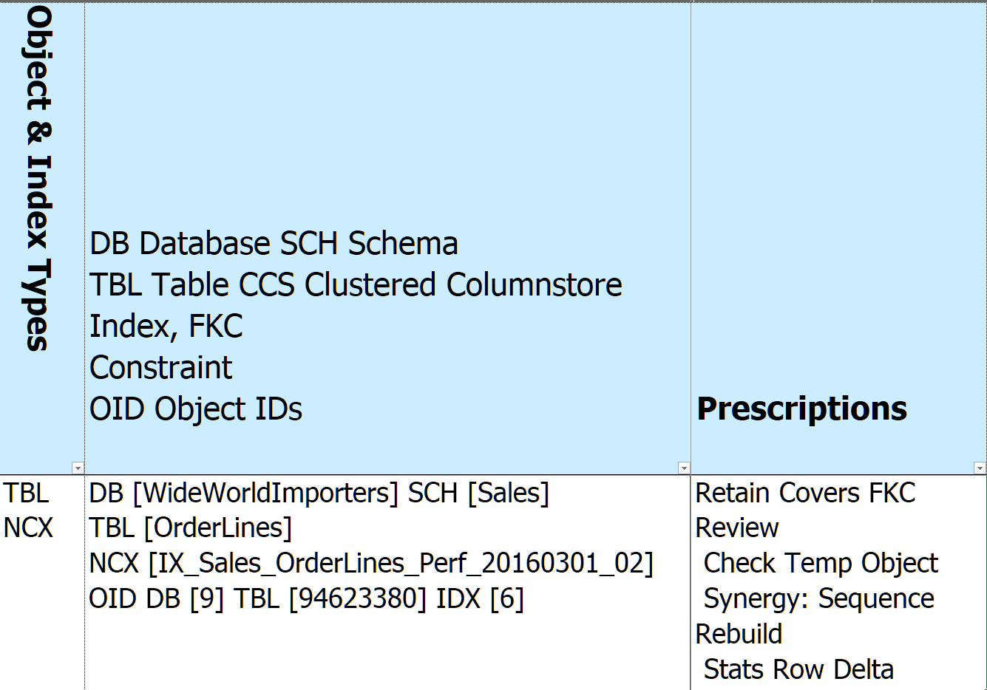
Notes:
27:00
Grabbed a representative row for a Nonclustered Rowstore index – NCX
IX_Sales_OrderLines_Perf_20160301_02
Index name & ID added to the names column
Prescriptions –
Retain – covered FKC
Review – name looks like it could be temporary (YYYYMMDD format)
Review – Synergy – Sequence – means that one or more index keys match in order
Rebuild – Stats Row Delta – row difference between last statistics update and physical table
Let’s Dive into Prescriptions

Slide 27
Index R(x) Prescriptions
Retain Constraints, Clustered, Foreign Key covers*, “gooder”, no writes
Replace* With updatable Nonclustered Columnstore (SQL 2016+ Enterprise)
Request Clustered indexes on Heaps, Missing Indexes adding value
Reject Missing Indexes that … don’t add value -or- table has/will have NCS
Remove Redundant, cost more than they benefit - Reads < 4 x writes
Write = (Spinlocks, Latches, Locks) + Buffer Cache + Log + Disk
Review “It Depends” for indexes tagged above
Rebuild Retained indexes that need refreshed Statistics or Reorg/Rebuild
Refactor Retained indexes benefiting from structural changes
e.g. Index partitions don’t match table partitions
*Based on parameter selected at run time
Notes:
30:00 DON’T CLICK
Take our 196 metrics, 500+ diagnostics, column synergies,
Create 95 prescriptions grouped in 8 categories
<*>
Retain – the easy one – do nothing – foreign keys, history tables, specialty indexes, contraints,
- “better” if overlaps/synergies
Replace – and flag extra columns that may be needed
Remove – if index not used but not written to – no harm no foul
Rebuild – FRAGMENTATION

Slide 28
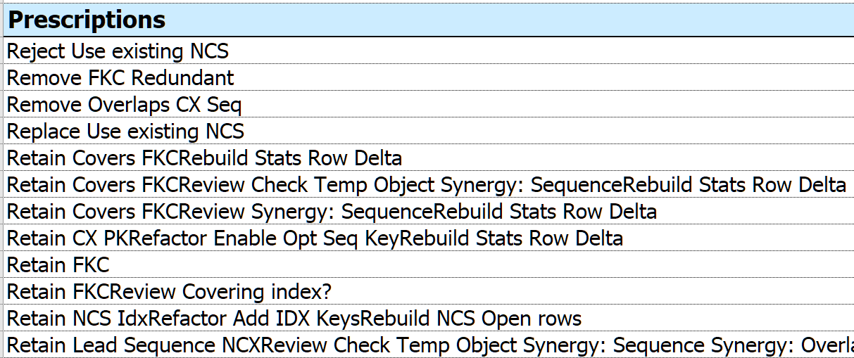
Notes:
31:00
What about the prescriptions for the table [OrderLines]?
Excel concatenates filters in dropdown
Too many to explore separately – let’s combine them

Slide 29
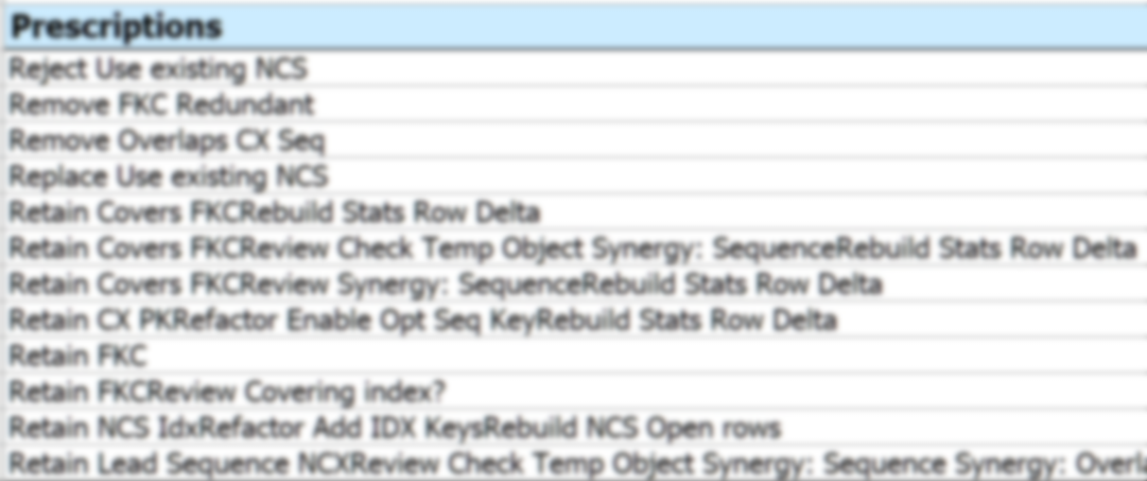
 | Principal Prescription | Related Prescription | Related Prescription
Remove Redundant Foreign Key | Remove FKC Redundant | Retain FKC | Retain FKC Review Covering index?
Redundant Indexes Covering Foreign Key | Retain Covers FKC Review Check Temp Object Synergy: Sequence Rebuild Stats Row Delta | Replace Use existing NCS
Clustered Rowstore Synergies | Retain CX PK Refactor Enable Opt Seq Key Rebuild Stats Row Delta | Remove Overlaps CX Seq
Nonclustered Rowstore Synergies | Retain Lead Sequence NCX Review Check Temp Object Synergy: Seq, Ovl, Con Rebuild Stats Row Delta | Replace Use existing NCS
Nonclustered Columnstore Insights | Retain NCS Idx Refactor Add IDX Keys Rebuild NCS Open rows | Reject Use existing NCS
Notes:
32:30
To simplify the next few slides inked related prescriptions together
All foreign keys
Indexes covering Foreign Keys
Clustered Index & Overlaps
Nonclustered index to keep over another
Nonclustered Columnstore & indexes that can be removed

Slide 30
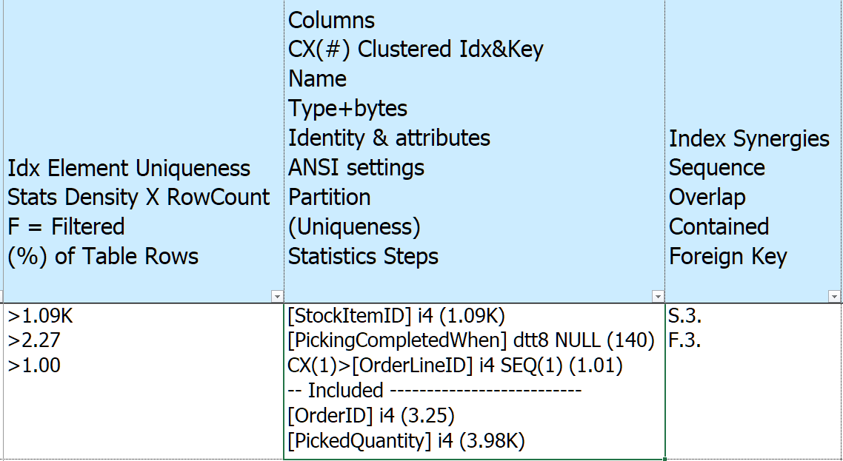
Notes:
33:30
Back to our selected index - IX_Sales_OrderLines_Perf_20160301_02
Lot to unpack – start with center column
Info of index key columns & included columns
<*> Name
<*> Data Type – i4 = Integer 4 bytes, dtt8 = 8 byte datetime2
<*> in parenthesis “uniqueness” from statistics = how may rows on average share a column value
<*> dtt8 DATETTIME2 8 bytes
<*> Null = NULLABLE
<*> CX(1)> = every nonclustered rowstore gets the clustered index added to it
<*> SEQ(1) = sequence, increment by 1, plus uniquifier if clustered is not unique
<*> Included
If there were other column properties would be expressed here too – e.g. if is sparse
To the left – Idx Element Uniqueness
For each additional element in index how many rows are expected to be returned on average
2 kinds of statistics – Histogram (200 buckets) and density (avg rows per combination of index keys)
If column filtered would show “F”
If uniqueness > 4% of table show %
To the right – Synergies
S = Sequence
F = Foreign Key

Slide 31
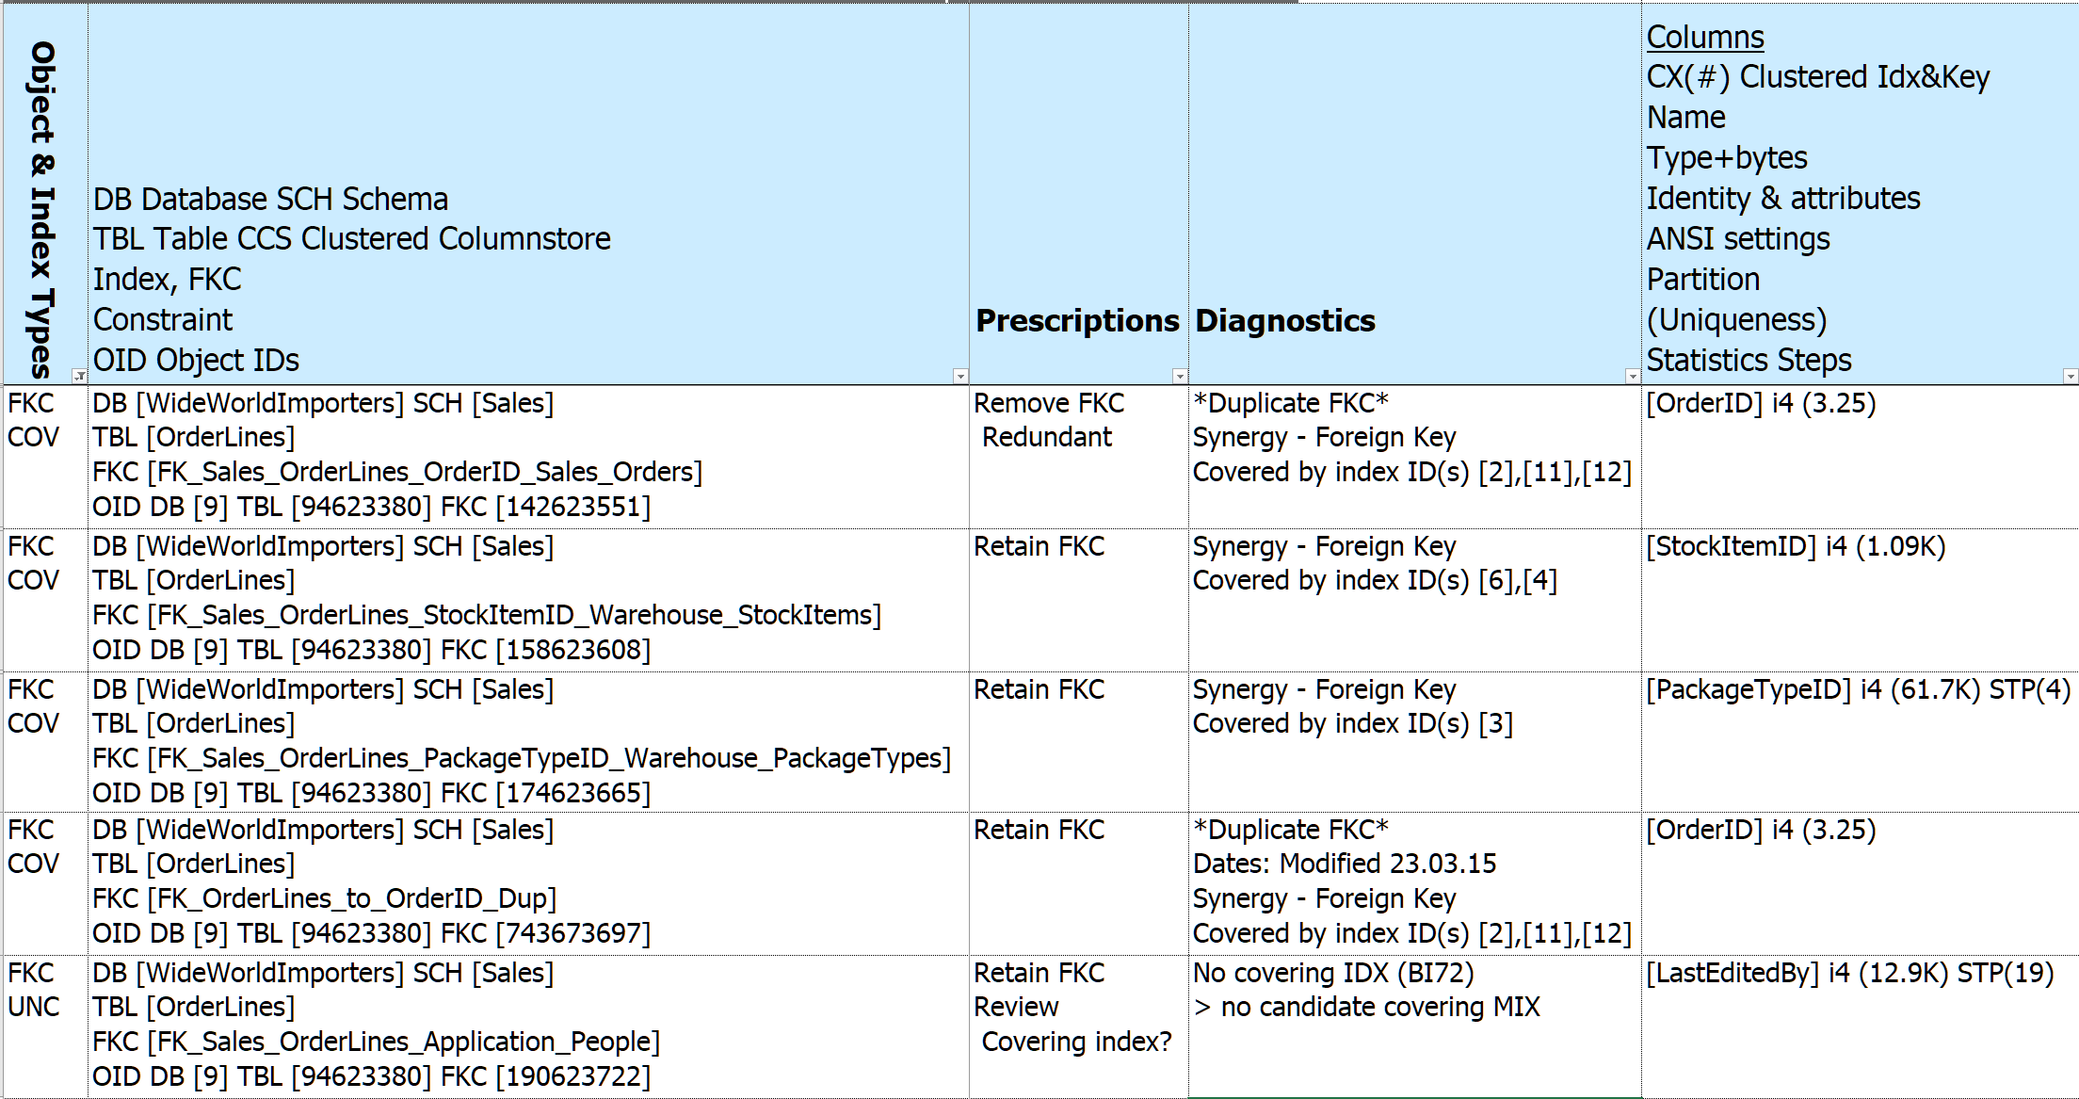
Prescription – Remove Redundant Foreign Key
 | Principal Prescription | Related Prescription | Related Prescription
Remove Redundant Foreign Key | Remove FKC Redundant | Retain FKC | Retain FKC Review Covering index?
Notes:
34:30
Prescription DEMO 1 - Foreign Keys – REMOVE Redundant Foreign Keys
SUBSET OF COLUMNS
<*> Covered foreign keys
<*> Uncovered Foreign Keys
<*> Removal flagged in the Prescriptions column
<*> Check out the columns in each FKC – duplicates – also flagged in Synergies column (bot shown)
<*> Diagnostics – drawn from Synergies
<*> Synergies
In the event of a tie keep the FKC that is:
Enabled, Trusted
Most columns in sequence matching order
delete_& update referential_action
Not system named
is_published, is_schema_published,is_replicated
Most recent created
<*> FKC without covering index – and no Missing Indexes calling out the “LastEditedBy” column

Slide 32
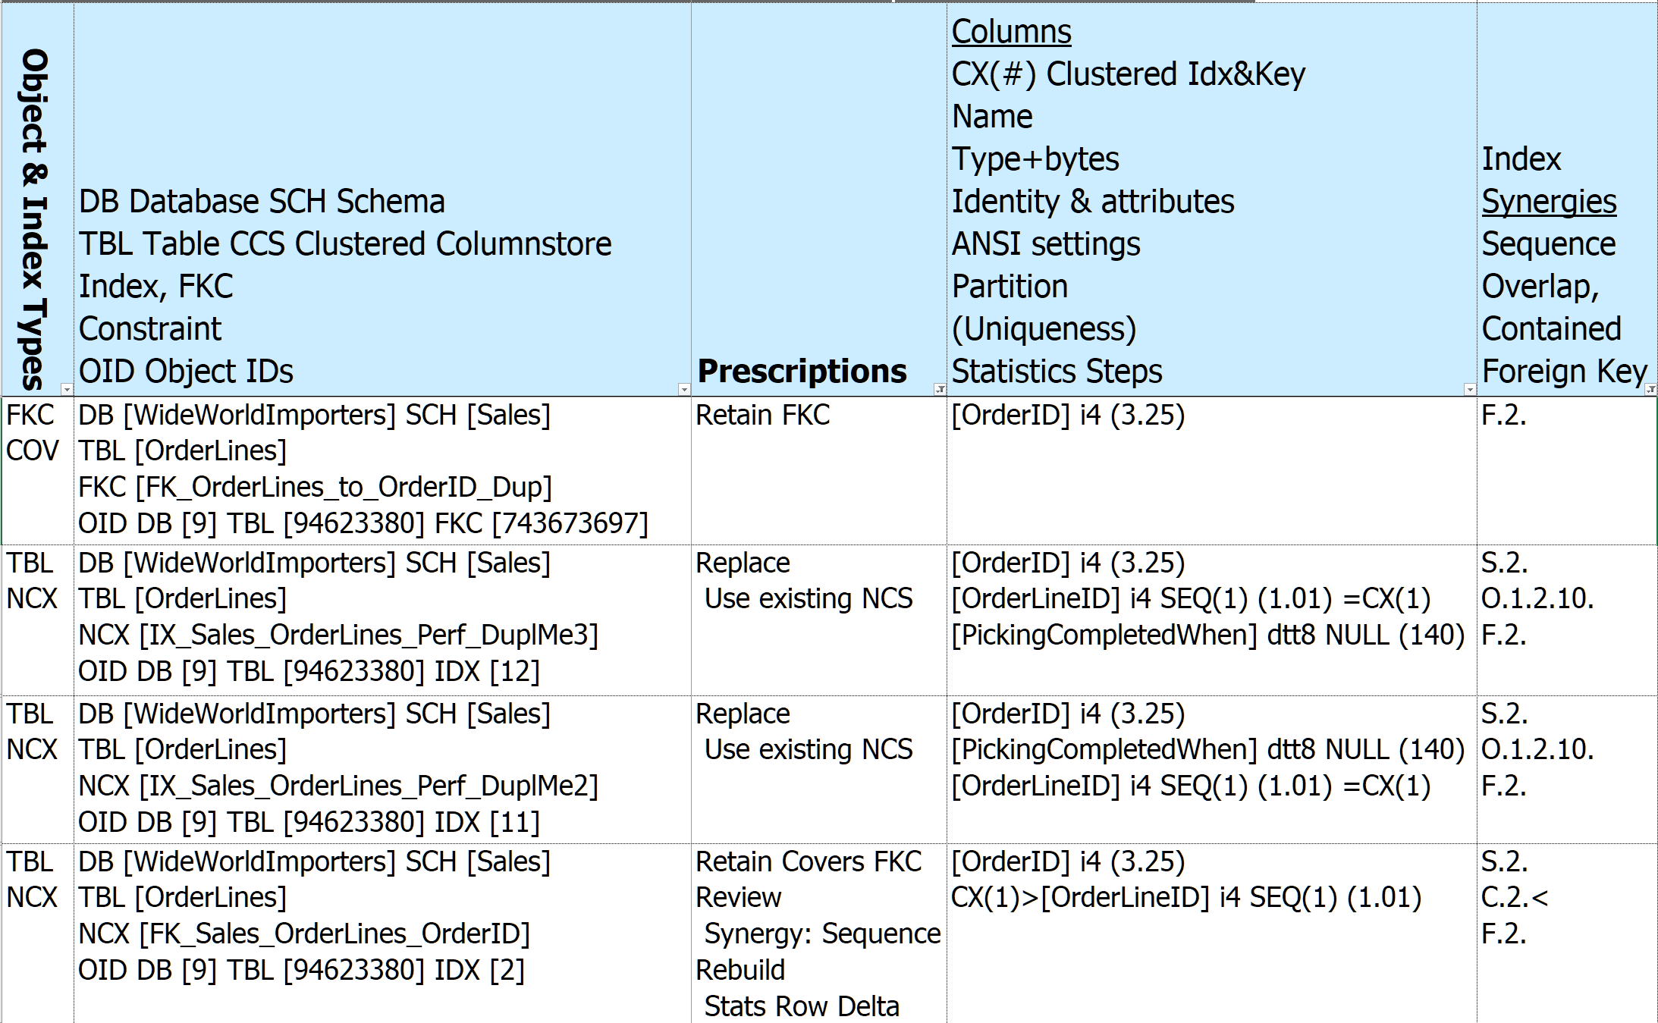
Prescription – Redundant Indexes Covering Foreign Key
 | Principal Prescription | Related Prescription
Redundant Indexes Covering Foreign Key | Retain Covers FKC Review Check Temp Object Synergy: Sequence Rebuild Stats Row Delta | Replace Use existing NCS
2 + Clustered
2 + Clustered
1 + Clustered
Notes:
36:30
Prescription DEMO 2 – Replace Synergy NCX
Retain Foreign Key Cover
Previously noted that this tables has an NCS, so take close look at all NCX
3 candidate NCX indexes to continue covering Foreign Key, all can be replaced by Nonclustered Columnstore
But NCS cannot cover FKC
So pick the smallest index to provide cover – selected index has only 1 column plus the clustering key
If a tie pick the one most used, then recently created
Diagnostics left off

Slide 33
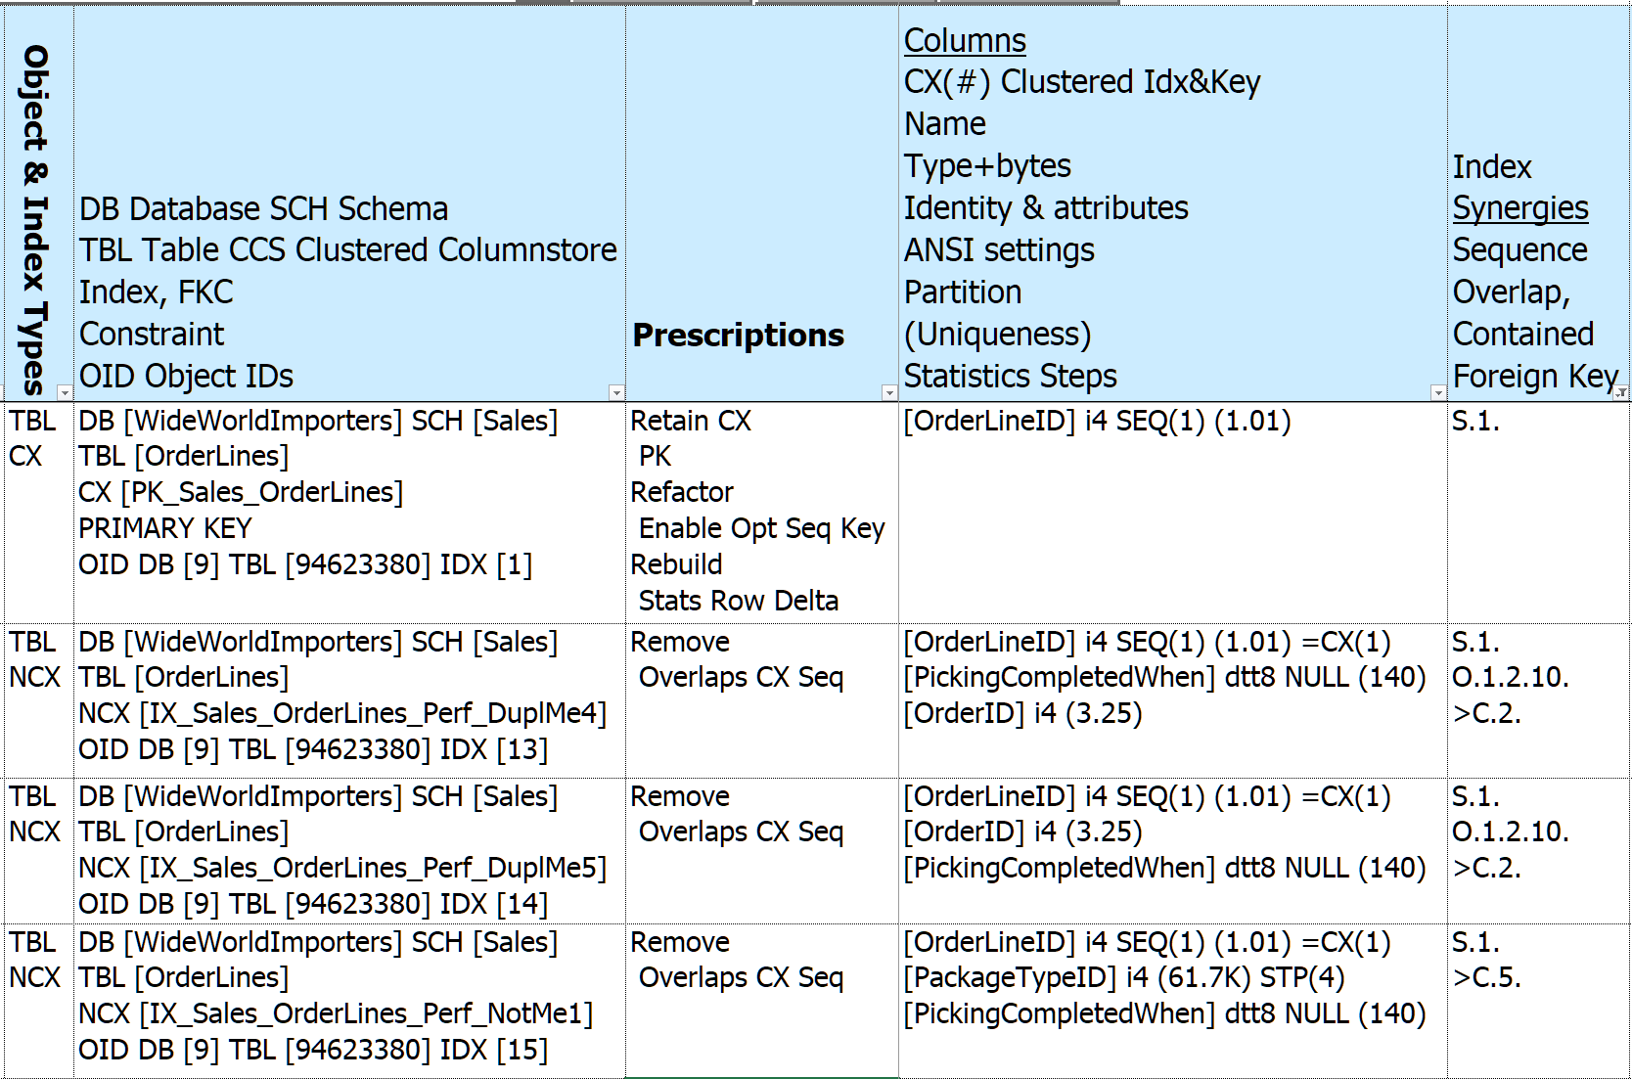
Prescription - Clustered Rowstore Synergies
 | Principal Prescription | Related Prescription
Clustered Rowstore Synergies | Retain CX PK Refactor Enable Opt Seq Key Rebuild Stats Row Delta | Remove Overlaps CX Seq
Notes:
38:30
Prescription Demo 3 – Clustered Index Synergy –or- NCX Overlaps CX
SUBSET OF COLUMNS
Diagnostics left off

Slide 34
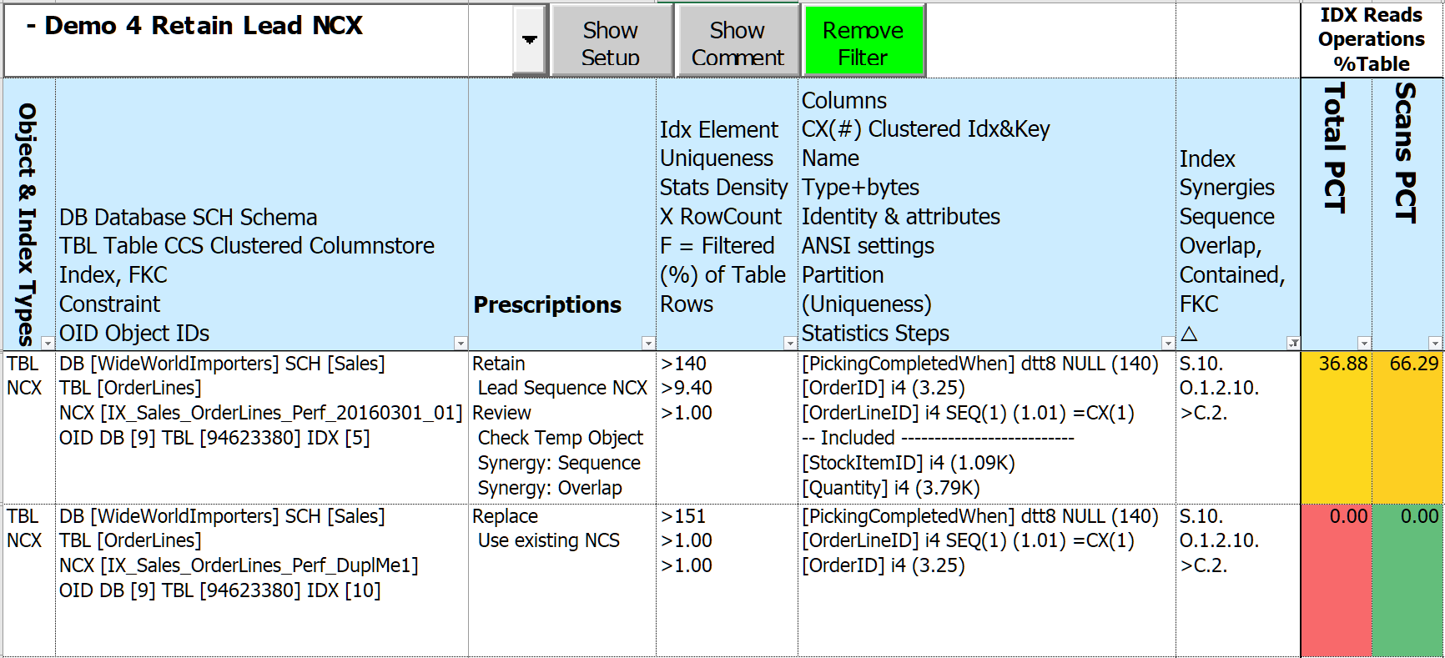
Prescription – Nonclustered Rowstore Synergies
 | Principal Prescription | Related Prescription
Nonclustered Rowstore Synergies | Retain Lead Sequence NCX Review Check Temp Object Synergy: Seq, Ovl, Con Rebuild Stats Row Delta | Replace Use existing NCS
Notes:
40:00
Prescription Demo 4 – Synergy Nonclustered Rowstore
SUBSET OF COLUMNS
Records in table 248K, so lead column uniqueness 140/248K not too many records expected to return
Column [PickingCompletedWhen] likely similar (hopefully growing over time)

Slide 35
Prescription - Nonclustered Columnstore Insights
 | Principal Prescription | Related Prescription
Nonclustered Columnstore Insights | Retain NCS Idx Refactor Add IDX Keys Rebuild NCS Open rows | Reject Use existing NCS

Slide 36
Updatable Nonclustered Columnstore - Enterprise Edition and SQL 2016+
Wicked fast
High data compression rates - smaller in-memory footprint
Batch execution - improve performance through Parallelism
Selecting & filtering on multiple index keys at once - reduces I/O
But!
1 per table – can cover most data types
Excluded types – geo%, hierarchyid, image, %text, sql_variant, timestamp, xml
Writes create Delta (Residual) Rowgroups and Deleted Bitmaps
Performance hit!
Can’t cover Foreign Key Constraints
Notes:
40:00
query results merged from 3 places!
1 per table – but can have all included column types
Reorg - Creates many small Rowgroups, reducing efficiency
Rebuild - Offline < SQL 2019, merges all Rowgroups, removes Deletes – Expensive!
probably best performed in dedicated maintenance window

Slide 37
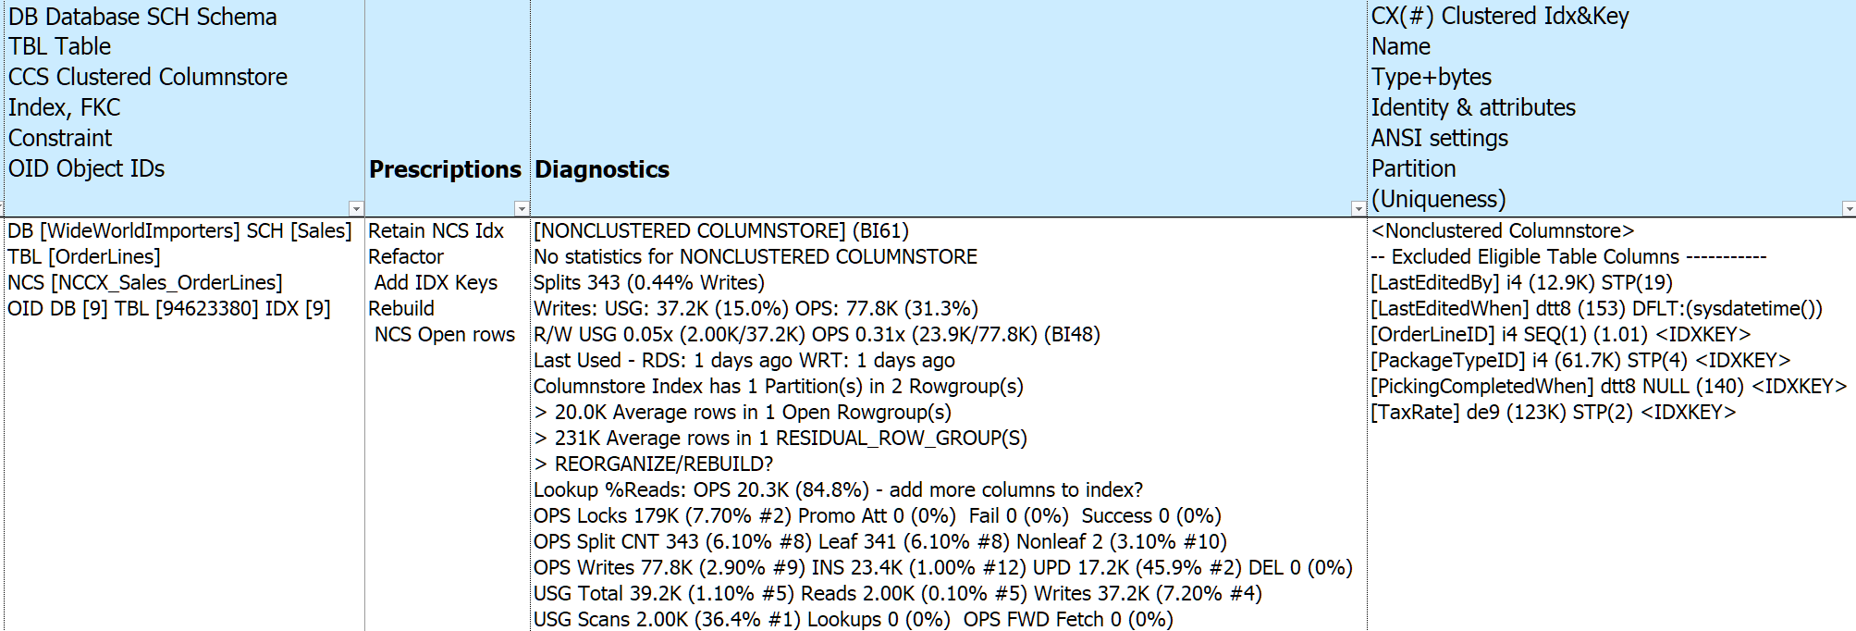
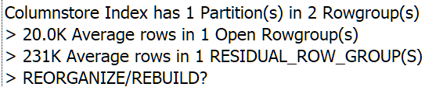
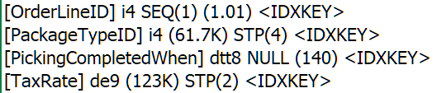
Prescription - Nonclustered Columnstore Insights
Notes:
42:30
Prescription DEMO 5 – Keep NCS - retain since somebody put time into NCS
BI61 – “Columnstore Index”
Refactor since there are index key fields not included – see “columns”
Plus a couple of other columns that can be included
Quite a bit of write activity, 1 existing open rowgroups and 1 residual (delta) rowgroups
Possibly schedule a rebuild task?
Low read to write ratio – not much SELECT inclusion yet
Otherwise those reads would be done on other indexes
Lots of lookups – 85% - hopefully adding more columns will reduce that alot

Slide 38
Diagnostics
500+ diagnoses
Instance & Database(s)
Tables (includes Views, SQL Table Valued Functions)
Indexes (includes Foreign Keys, Constraints, Missing Indexes)
Identify items that “stand out”
Non-default properties, settings, parameters
High proportion of Priority Metrics
Unused or empty objects
“Good to know”
“Key” configuration info - Server, Instance, Database, Query Store …
Dates: Last Read / Written / Modified / Created / Statistics Updated …
Version Aware – don’t ding SQL 2012 for new feature in SQL 2022
Notes:
43:00
Previous slide introduced “Diagnostics”
History and Internal Tables given a pass (mostly)
Link to BlitzIndex when same item found (57 items)

Slide 39
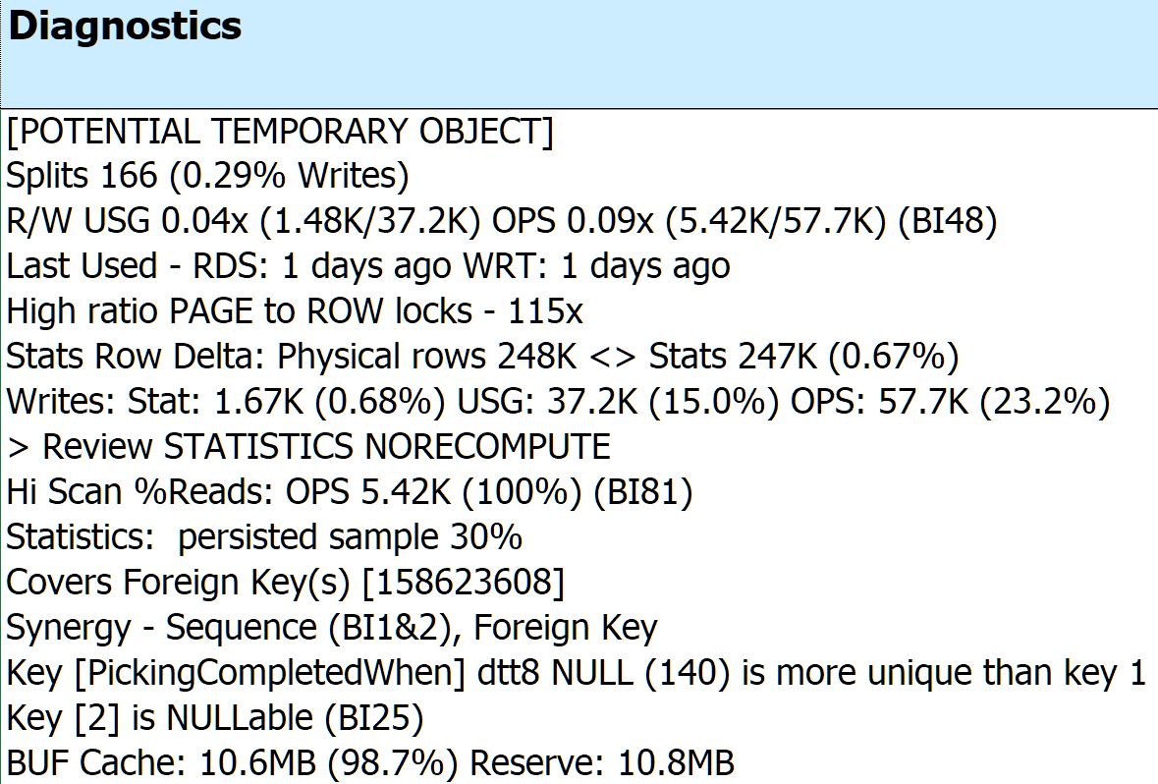
IX_Sales_OrderLines_Perf_20160301_02
Notes:
46:30/03:00 Click on a cell resizes width & height – click another cell & previous cell shrinks back
Blowing up the details for Sample index:
Diagnostics specific to index IX_Sales_OrderLines_Perf_20160301_02
percents computed against table totals
<*>References sp_BlitzIndex Checks by Priority (BI##) from Brent Ozar
<*> [POTENTIAL TEMPORARY OBJECT]
<*> date embedded in the name YYYYMMDD
<*> Splits 166 (0.29% Inserts + Updates)
3 significant digits
<*> R/W USG 0.04x 25 writes for every read OPS 0.09x 11 writes per read (BI48)
<*> KEY [PickingCompletedWhen] has 91 records per value, key 1 [stockitemid] has 1100
<*> KEY [PickingCompletedWhen] is NULLABLE

Slide 40
Execution & Parameters
Parameter Default
Database to include ALL USER DB
Foreign key coverage Keep, add new from Missing Indexes
Use/Create Nonclustered Columnstore YES, if 2016+ & Enterprise
Versions
SQL Server 2012+ (when IIF() function introduced)
Azure (mostly)
Notes:
48:30
Cover if referential_action

Slide 41
Making Changes to Indexes
So what do we do with all of our prescriptions?
SQL Server Standard Edition means no ONLINE index changes
Much interdependency between indexes and other elements
Clustered index changes work best with no other indexes
Audit & History tables may needs dropping & rebuilding
Foreign Keys and other Constraints may need dropping and rebuilding
Special cases - possible data and application issues
There’s never enough Log file space
Scripting DDL changes best left to “experts”
Notes:
49:30
Ignoring Duplicate keys – inserted rows violating uniqueness are ignored
possible data and application issues
Allowing row & page locks
Computed columns – persisted in index
Filtered indexes
Indexed views
Trusting & not Ignoring Duplicate keys may expose hidden issues

Slide 42
Making Changes to Indexes (Continued)
A method that’s worked for me:
Clone structure of target database
Apply changes to clone to produce improved “end state”
Create delta scripts using favorite DDL comparison tool: target -> ”end state”
Start creating “rollback code” by comparing in the opposite direction
Apply delta scripts to target database
Re-compare “end state” to target database
Execute rollback code if SHTF
Consider batching changes by table
More time consuming to script
Expedites rollbacks
Time estimates in lower environments cannot be extrapolated to Production
Notes:
50:00/2:00
Depending on where problem occurs at what stage in the process, rollback code may be incomplete
Many DDL comparison tools batch up all related activities – can be difficult to unwind if failure

Slide 43
Disclaimers!
All change has unintended consequences
It ALWAYS depends!
No express or implied warranty as to fitness for “your situation” – test first!
Don’t boil the ocean
Prioritize
Start small
Rinse & Repeat
Need to identify & measure “Success”
What’s a baseline?
Know when to say “When”
Notes:
52:30/01:00
With unique “opportunities” for improvement
Baseline – capture meaningful application-level statistics and compare as changes are made
Stop when performance goals are met

Slide 44
How can you Help?
Looking for “volunteers” to help speed tool development
Workbook labeling, cell comments, and documentation
Azure (all flavors)
Tables - Ledger, Graph, Internal
Indexes - XML, Fulltext, Spatial, Hash
Table Valued Functions
Identify Edge Cases
Additional Execution Parameters
Testing against real workloads
Bug hunts & error handling
“Like” to be able to retain a copy of captured structures and metrics
See links to source at end
Notes:
53:30
*26K lines of T-SQL and VBA*
Willing to trade consulting time for help in making this a useful tool for the SQL community

Slide 45
There are no stupid
Questions?
Notes:
55:00/4:30
Where worked best – OLTP, SQL2016, 1.5TB, 4 DB; 10K/hr cause infinite slowdown
applied SQLXL_Index, dropped 400 indexes, added 200
tested to 25K, next busy season no issues.
Tested to 75K – still no issues
Busiest Table had 17 columns & 29 indexes. When finished 1 CX, 2 NCX, 1 NCS
Where worked least – DW, SQL 2014, 1TB, 2 DB, multi-tenant, using Cognos dashboard
Average query 8 seconds, average dashboard had 10 objects, could run 4 in parallel – 20 seconds per dashboard
Could not use Updatable NonClustered Columnstore since 2014
Threw CPU, RAM, faster I/O at it
Partitioned tables & indexes, added filtered Indexes & statistics, rebuilt indexes and statistics after every load
Added even more indexes
Rewrote Cognos queries into procedures, average execution time dropped below 3/10ths second
How long to Run
What’s Next

Slide 46
Thanks for coming!
Bill Sanscrainte
linkedin.com/in/billsanscrainte
Bill@Sanscrainte.com
Find presentation, spreadsheet, & T-SQL code at
https://github.com/SQLXL/SQLXL
Link to sp_Blitz_Index Checks
https://github.com/BrentOzarULTD/SQL-Server-First-Responder-Kit/blob/dev/Documentation/sp_BlitzIndex_Checks_by_Priority.md
Notes:
59:30/00:30

